Slide 1
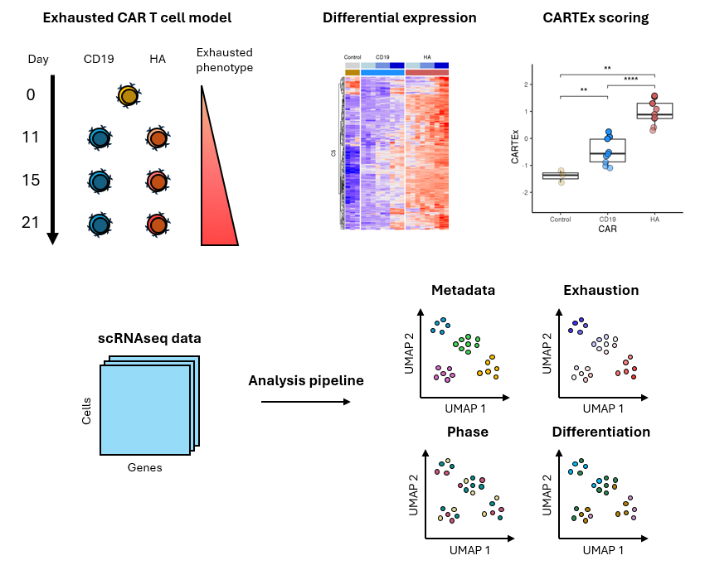
CARTEx project
Graphical abstract

Slide 2
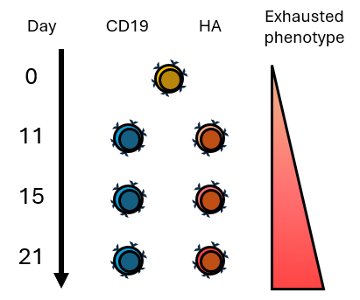
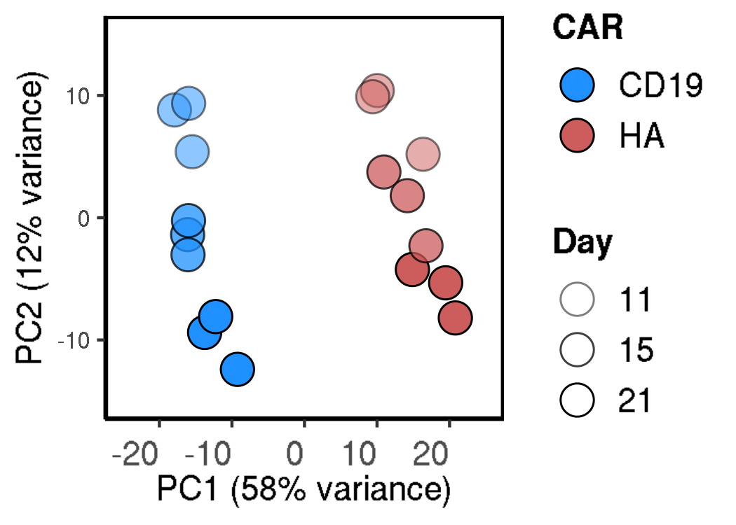
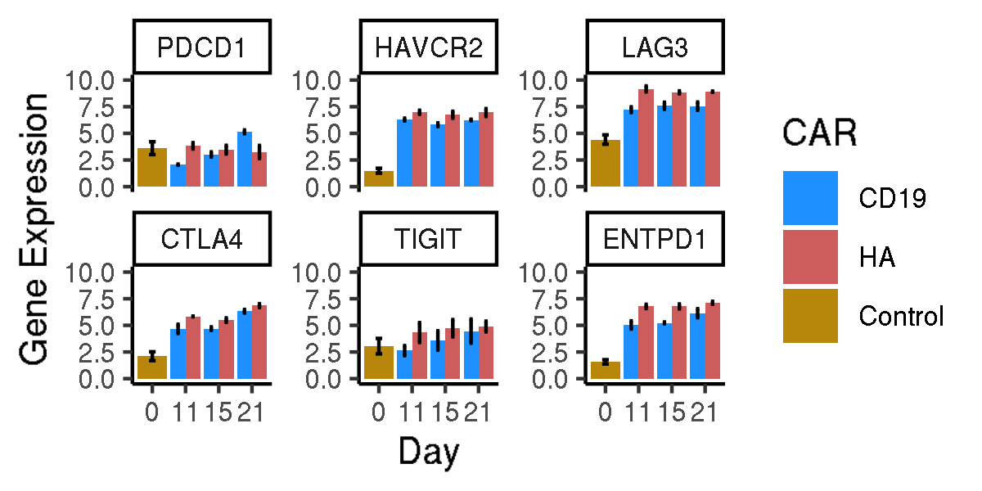
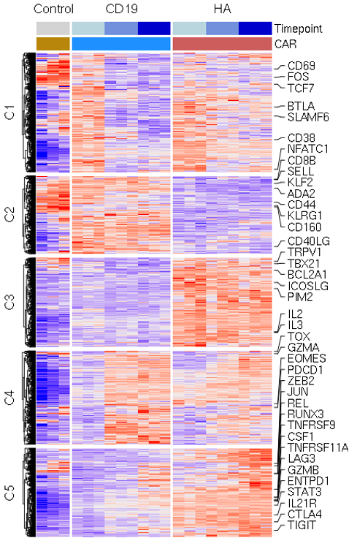
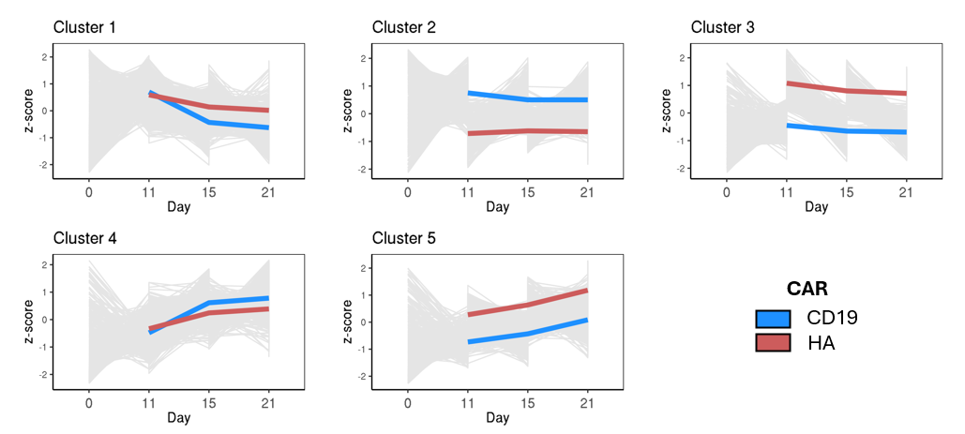
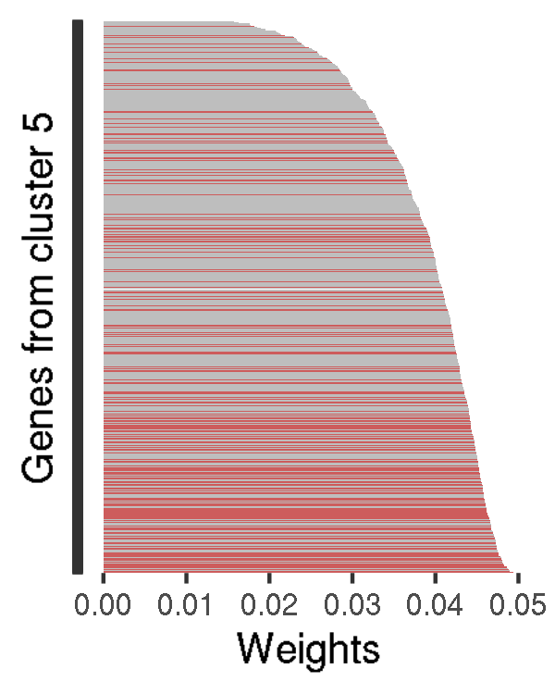
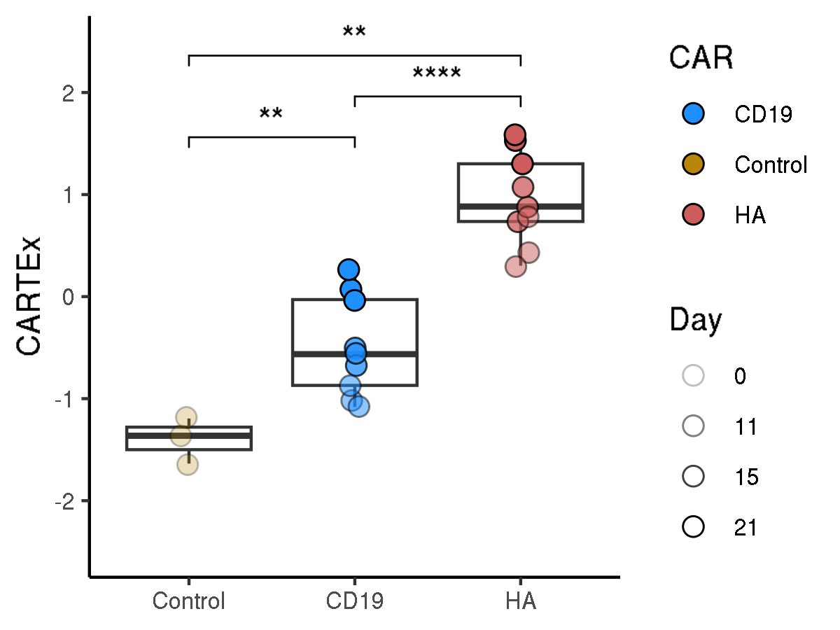
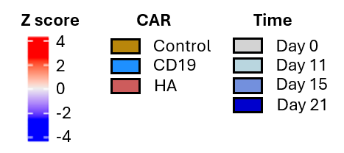
CARTEx project
Figure 1. Bulk RNA sequencing of functional and exhausted CAR T cells across 21 days
A
B
C
D
E
F
G

Slide 3
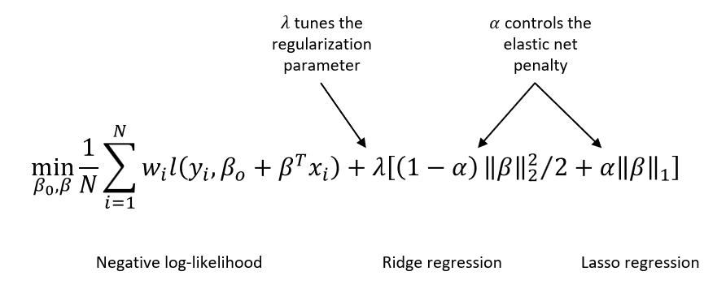
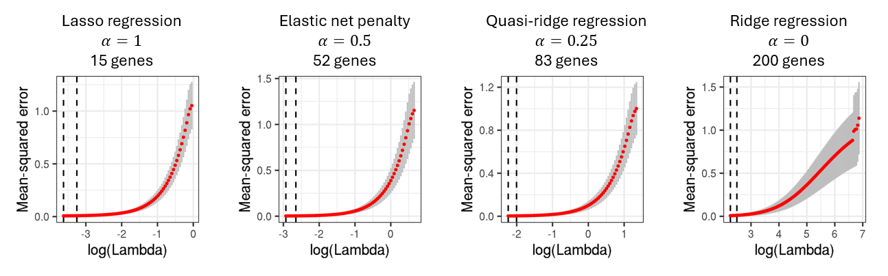
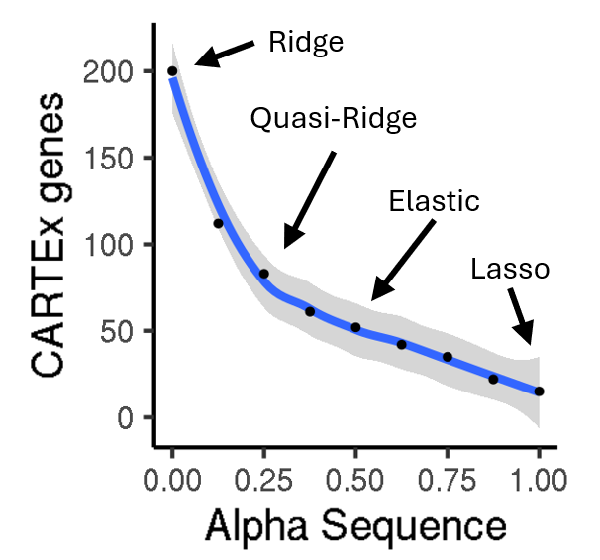
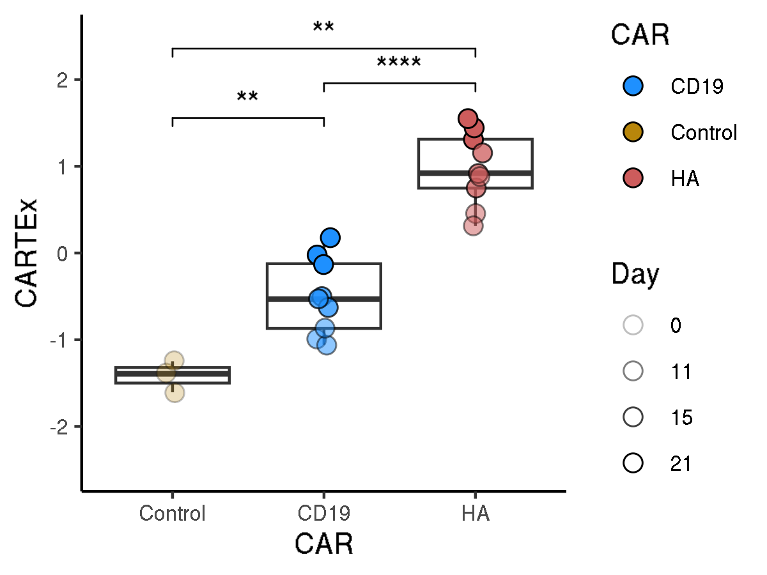
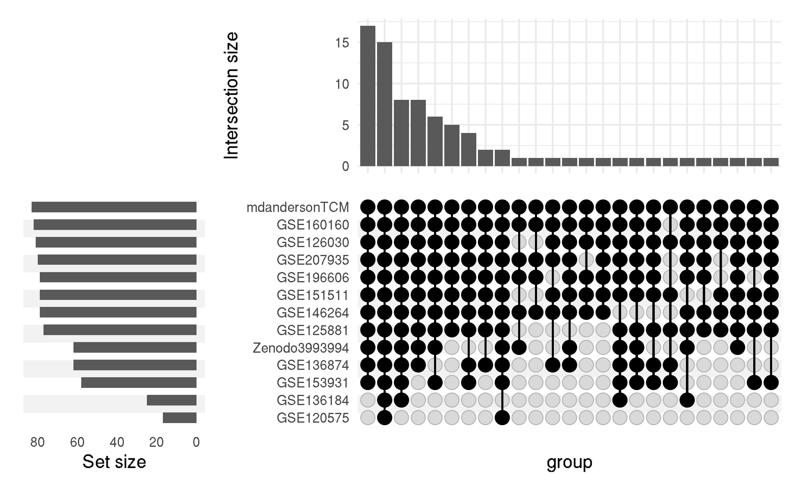
CARTEx project
Supplementary Figure 1. glmnet
A
B
C
D
E

Slide 4
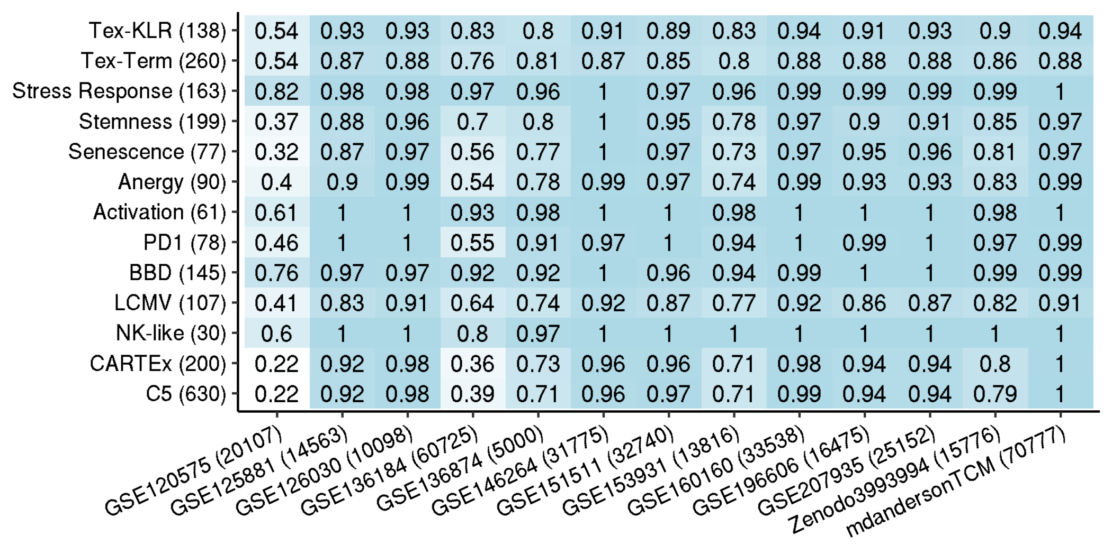
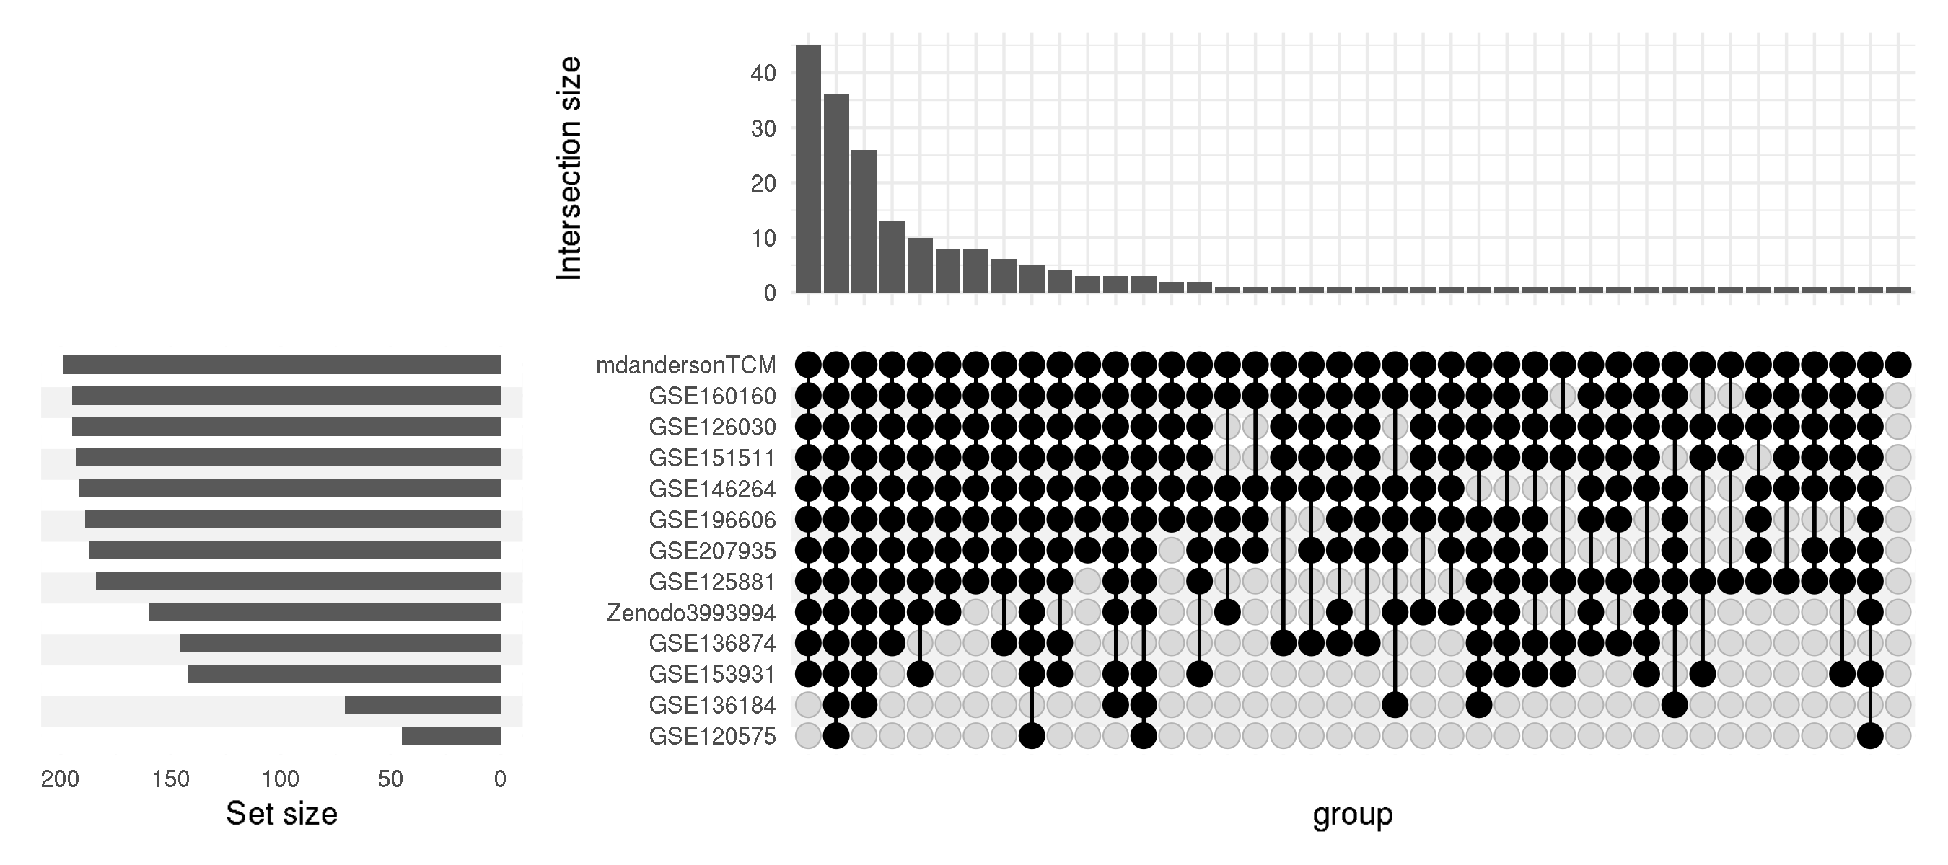
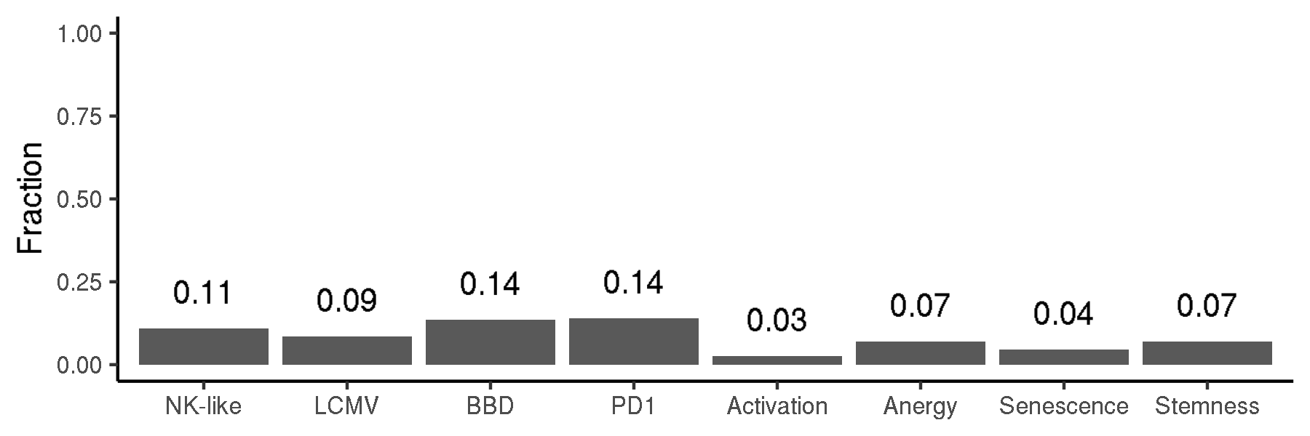
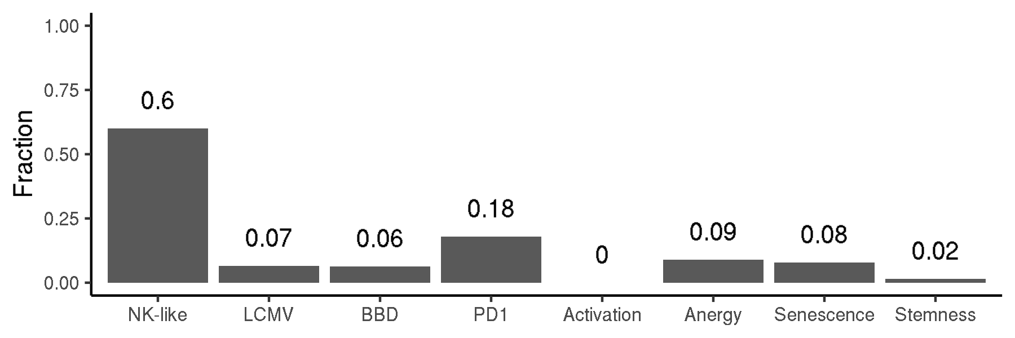
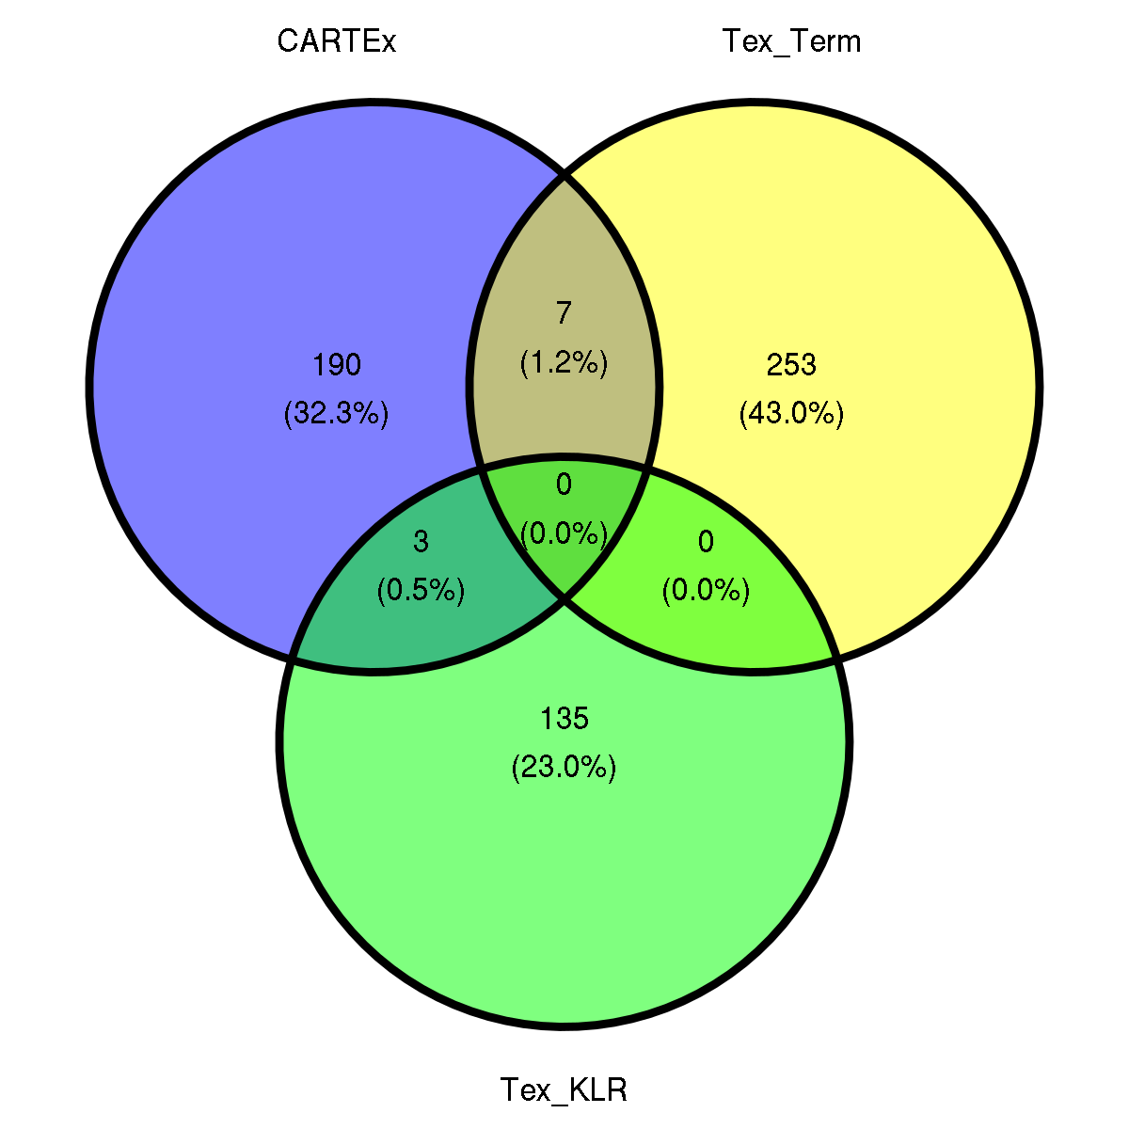
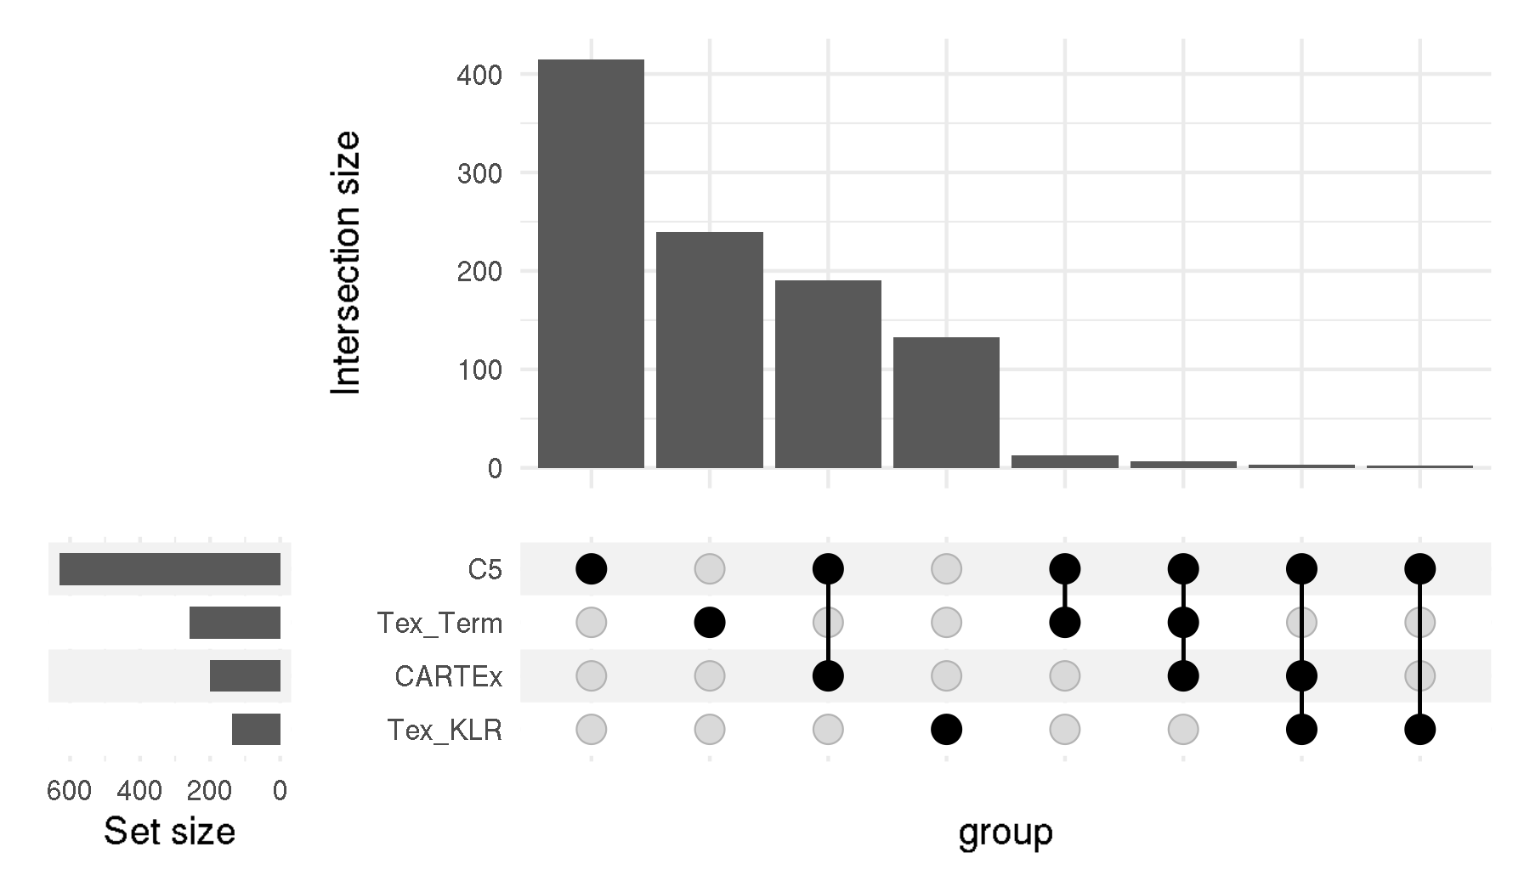
CARTEx project
Supplementary Figure 2. Signature representation
A
B
C
D

Slide 5
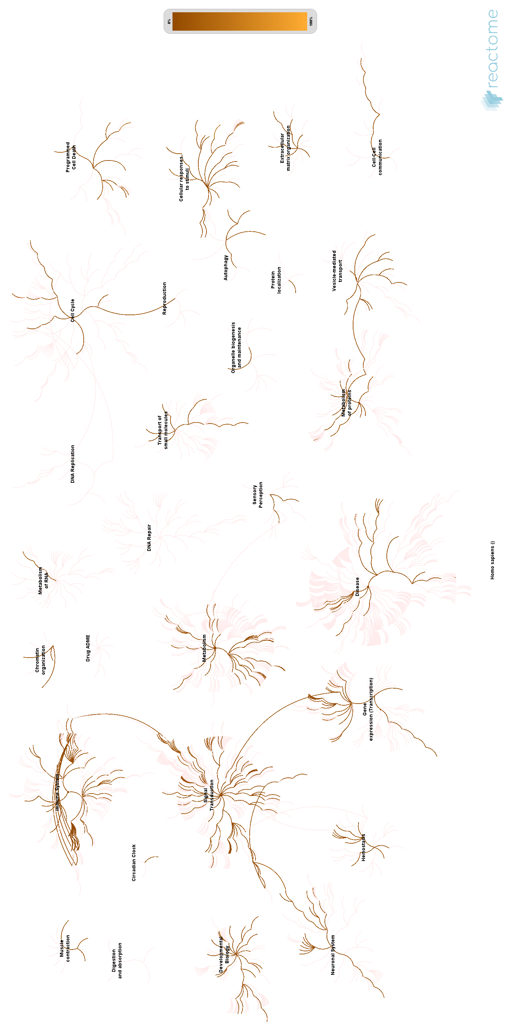
CARTEx project
Supplementary Figure 2. continued
E

Slide 6
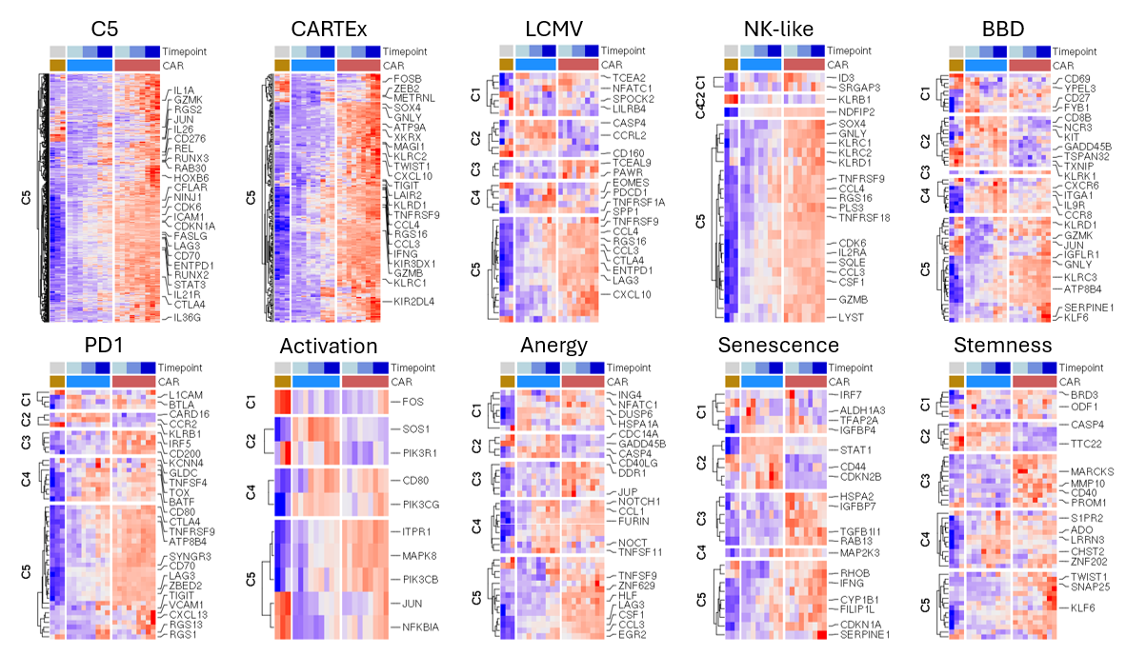
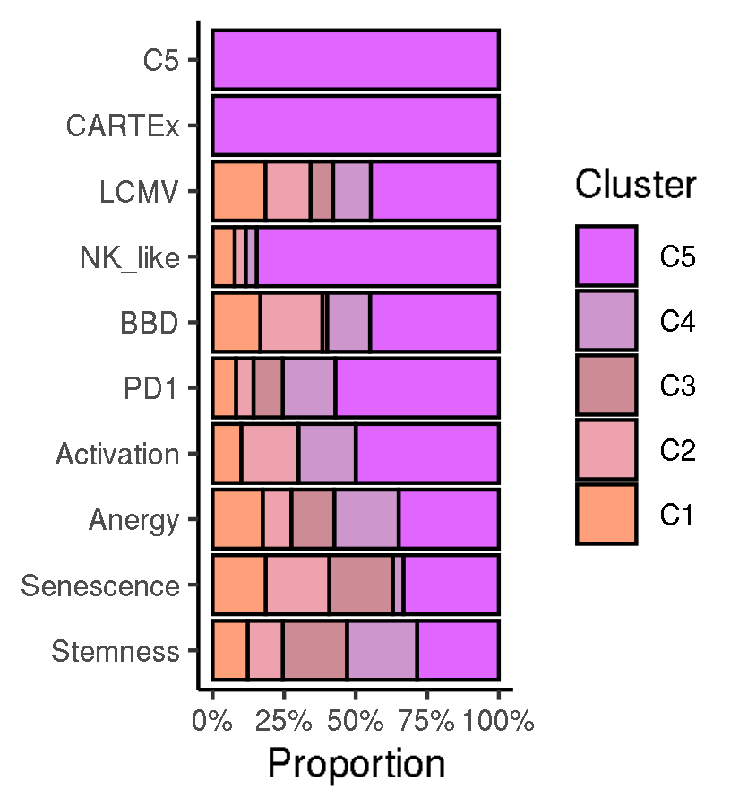
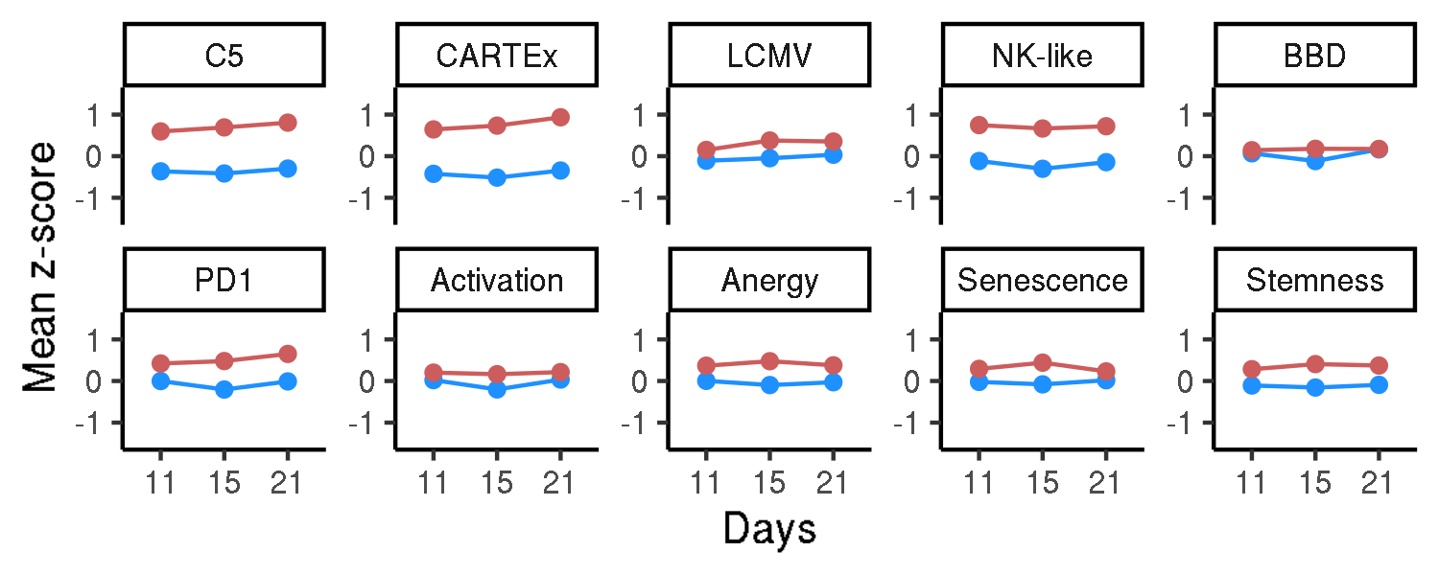
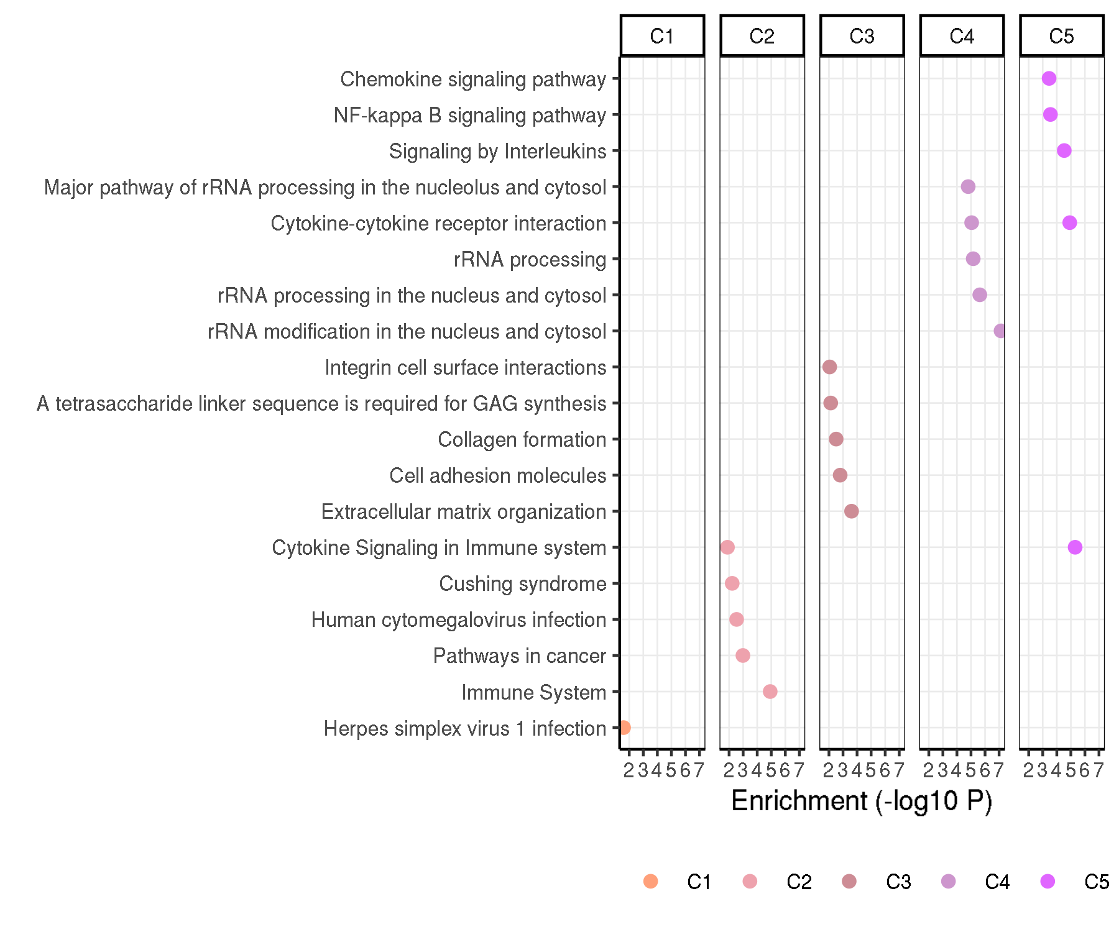
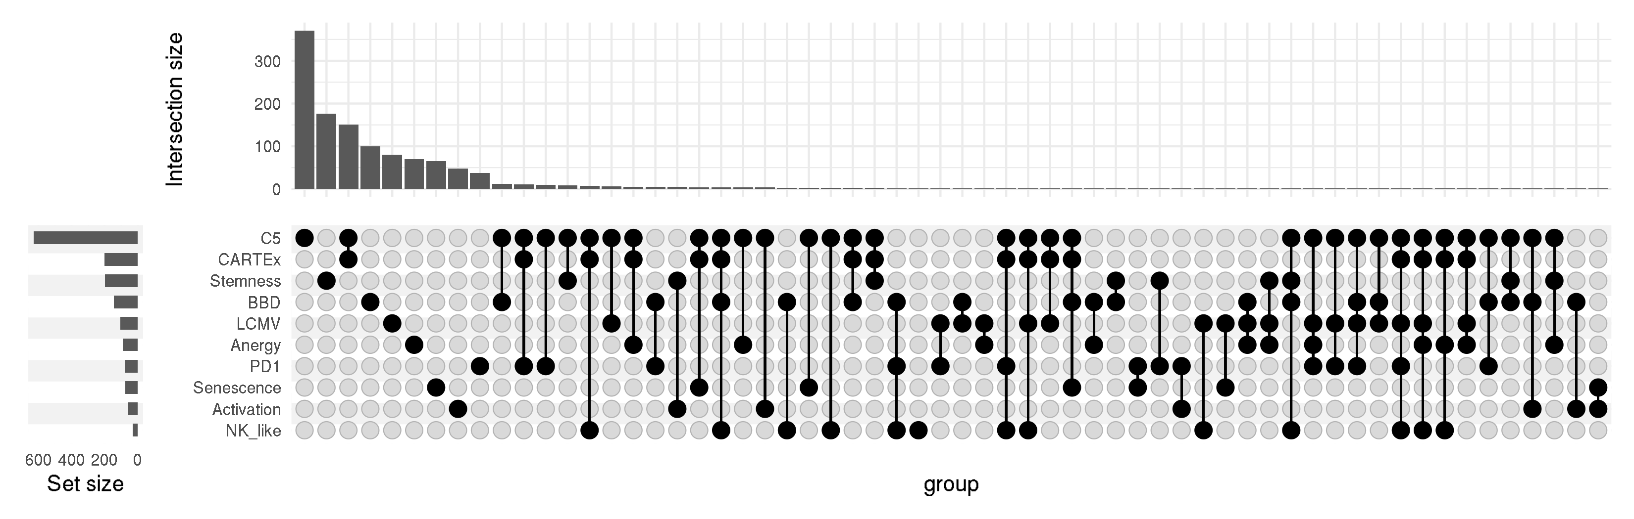
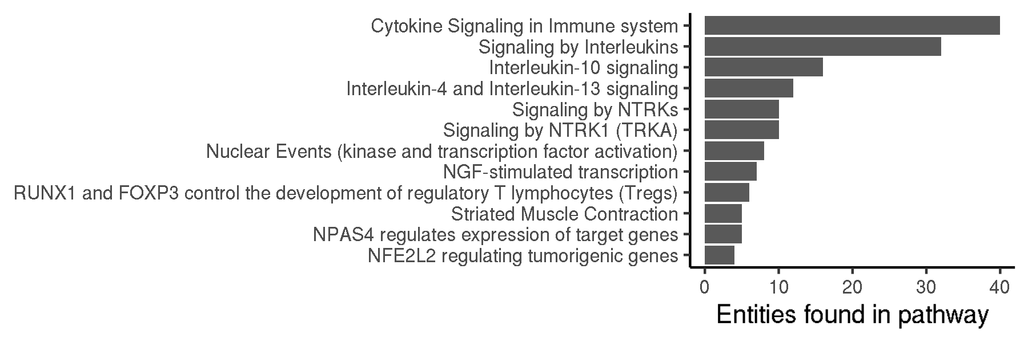
CARTEx project
Figure 2. Biological context / Evaluation with other exhaustion and cell state signatures
A
B
C
E
D
F

Slide 7
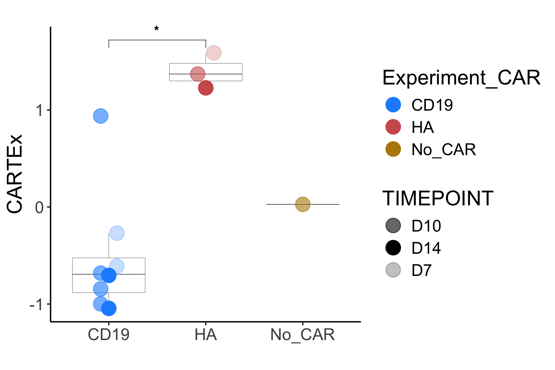
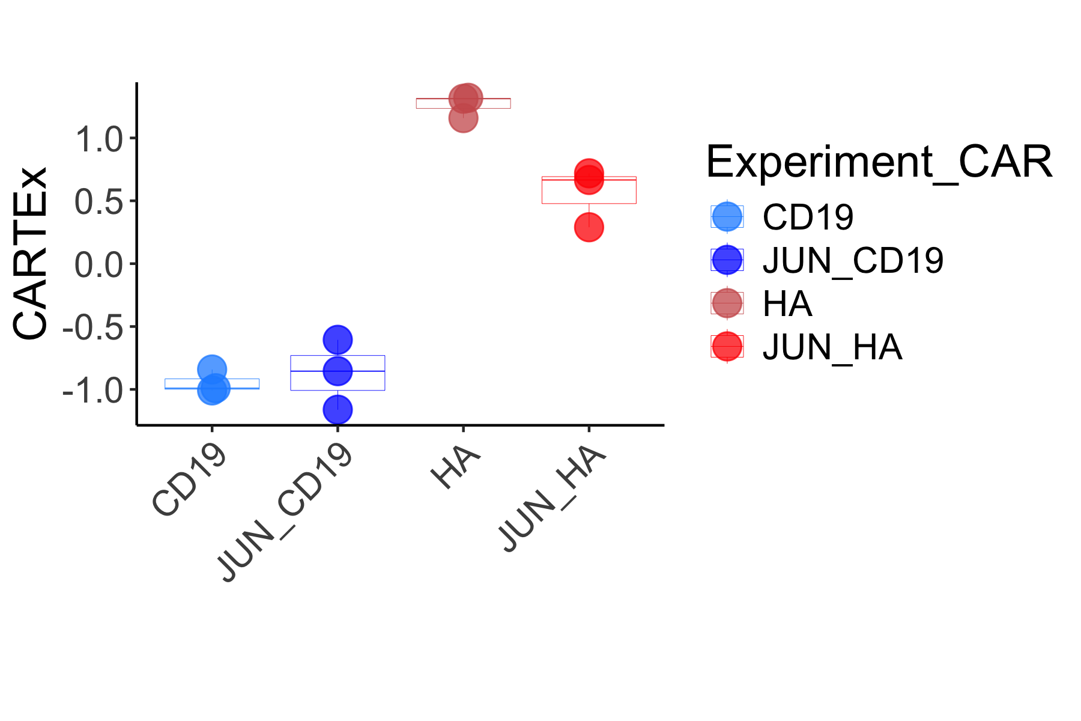
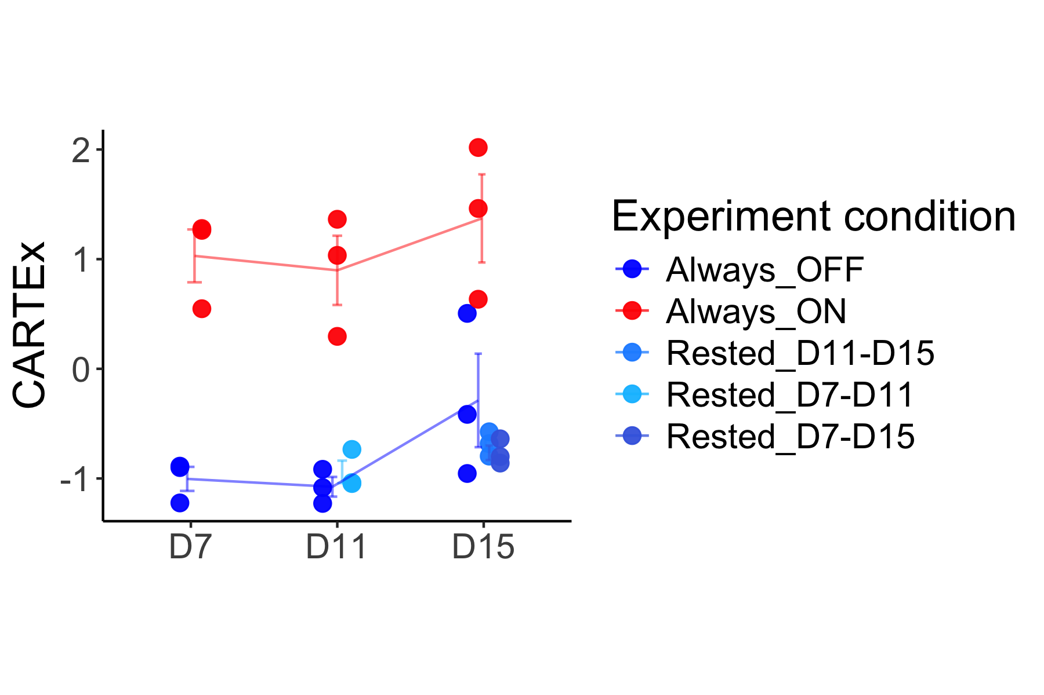
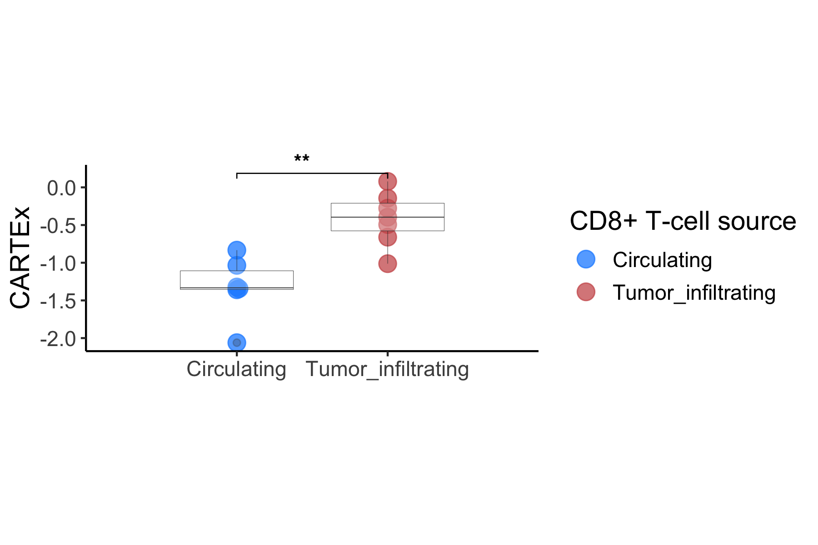
CARTEx project
Supplementary Figure 3. Applying CARTEx signature to bulk RNA sequencing data
A
B
C
D

Slide 8
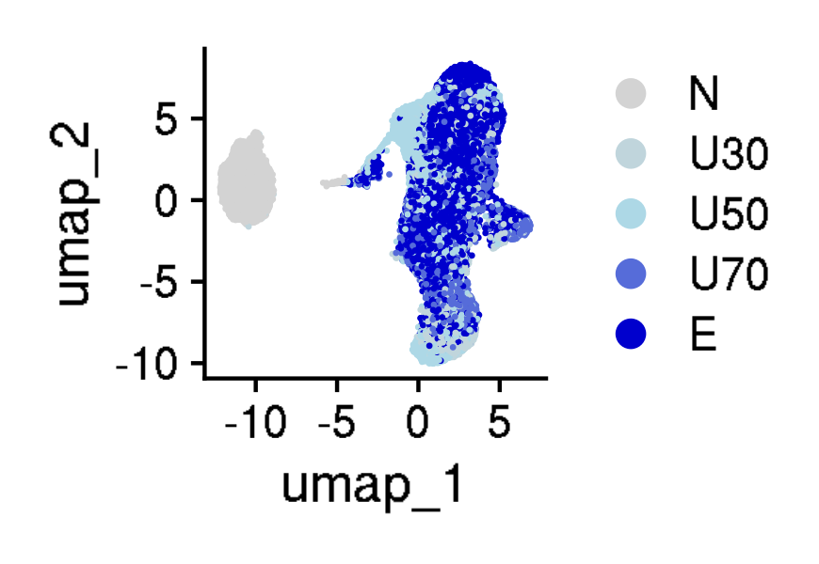
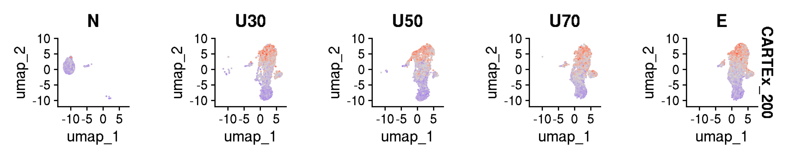
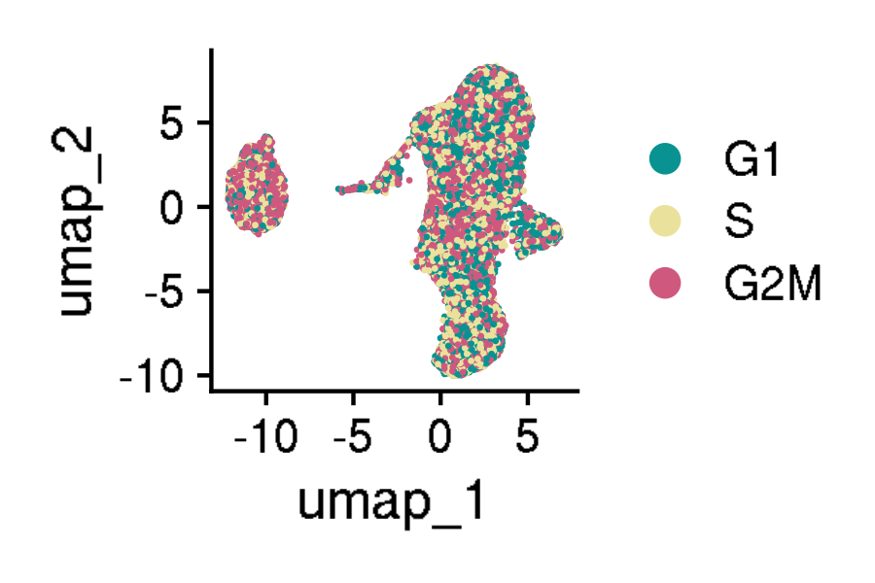
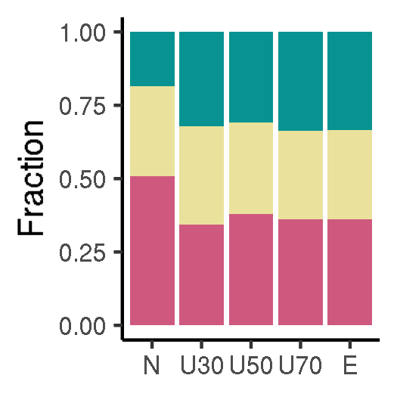
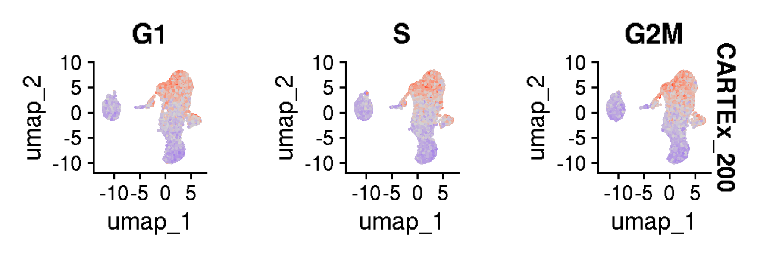
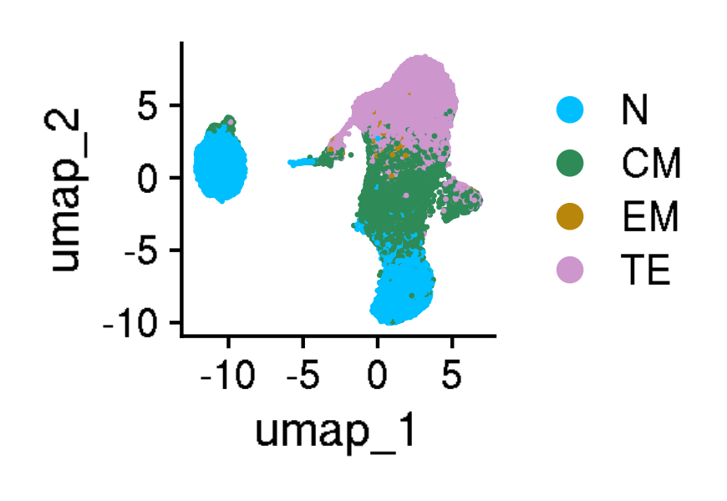
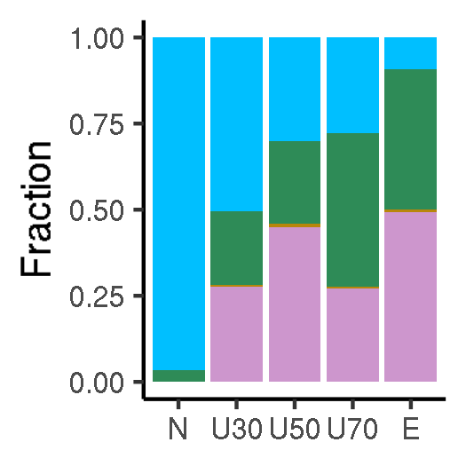
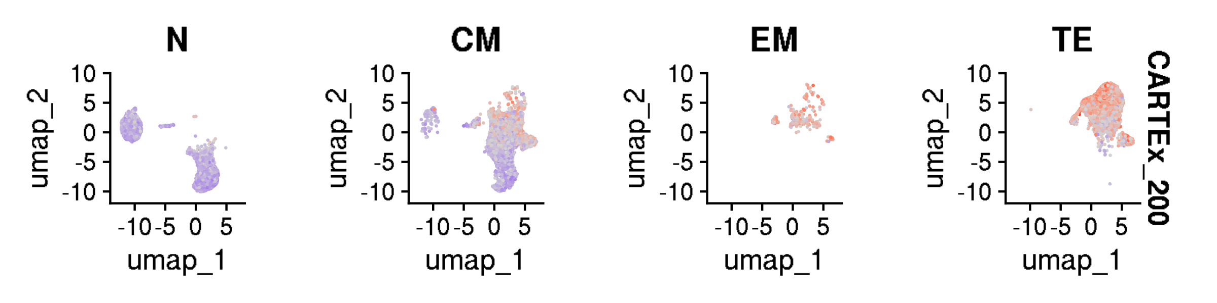
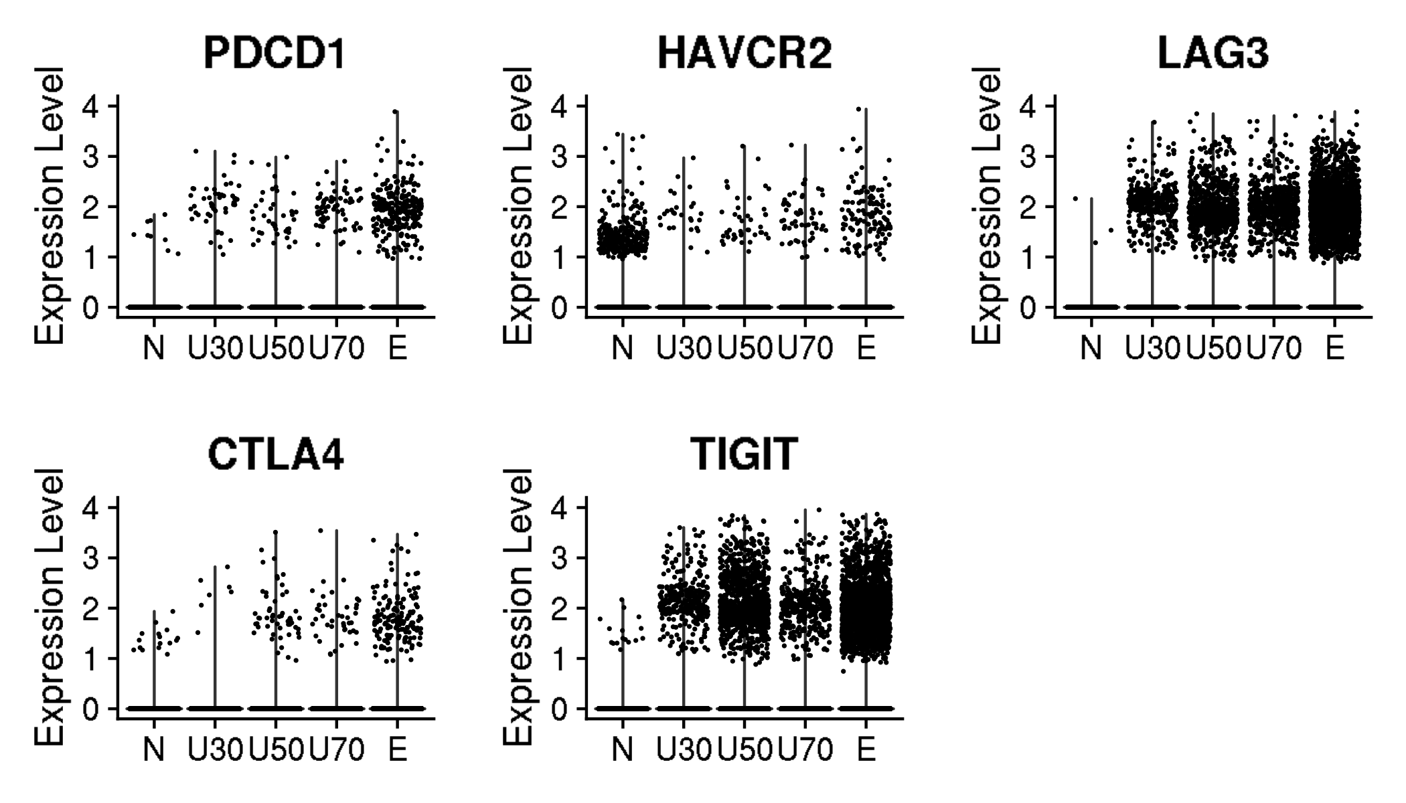
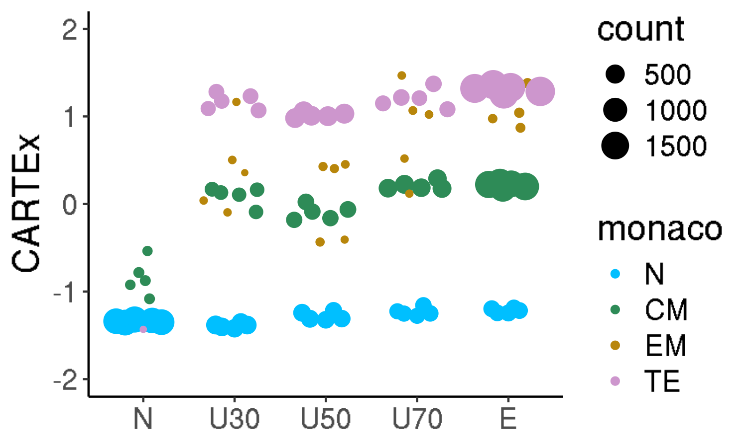
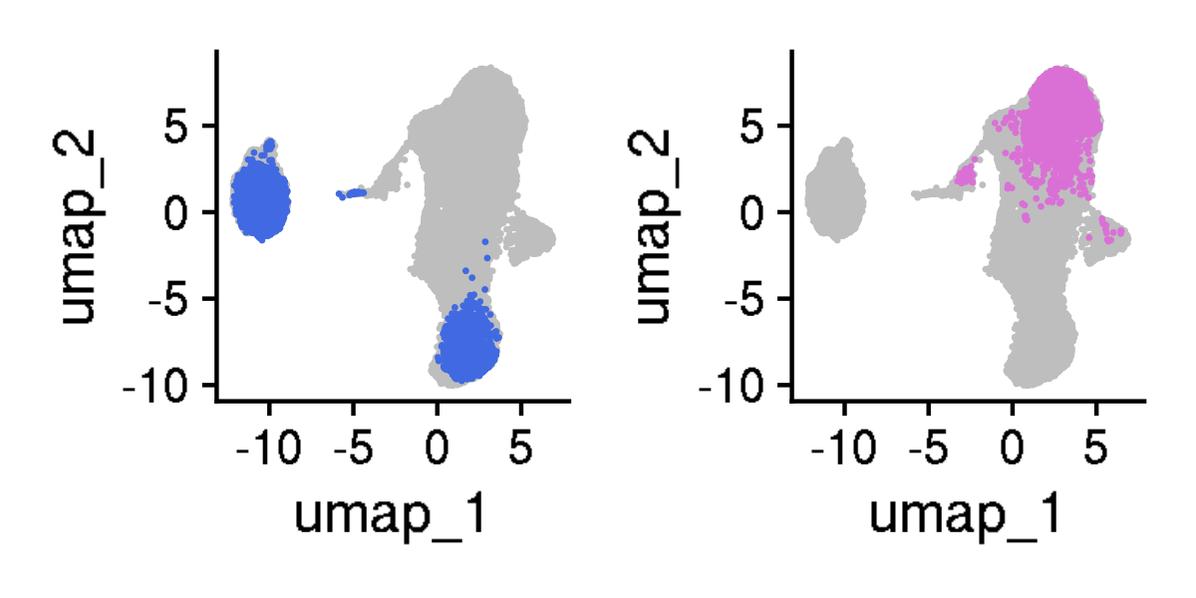
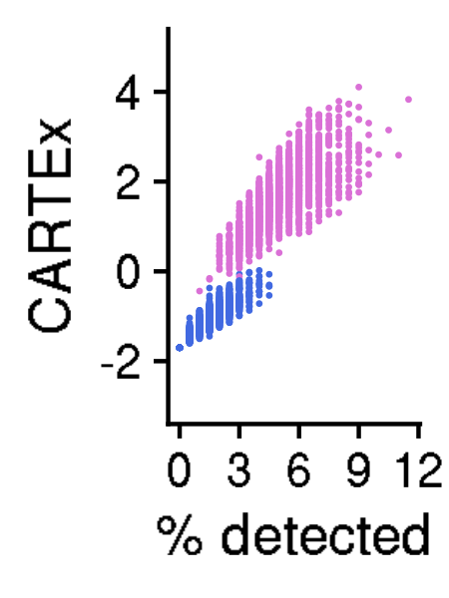
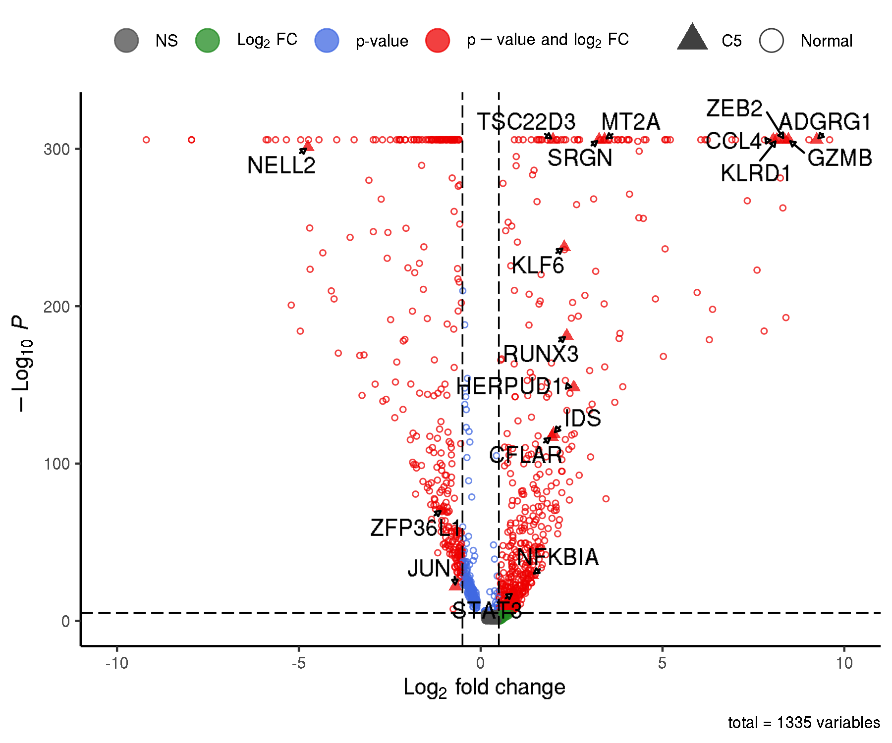
CARTEx project
Figure 3. T cell exhaustion is distinct from aging, cell cycle, and differentiation
A
B
C
D
E
F
G
H
I
J
K

Slide 9
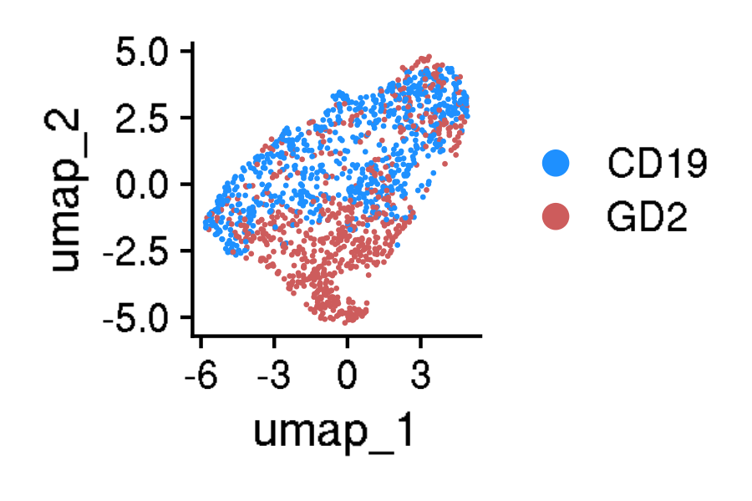
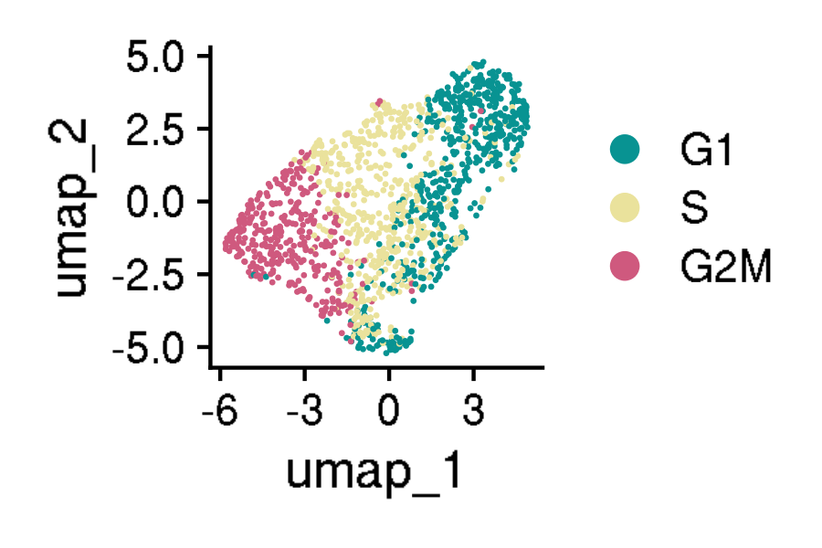
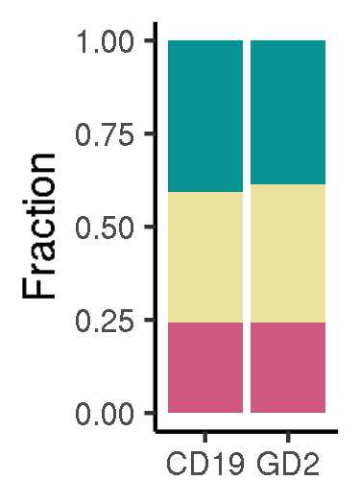
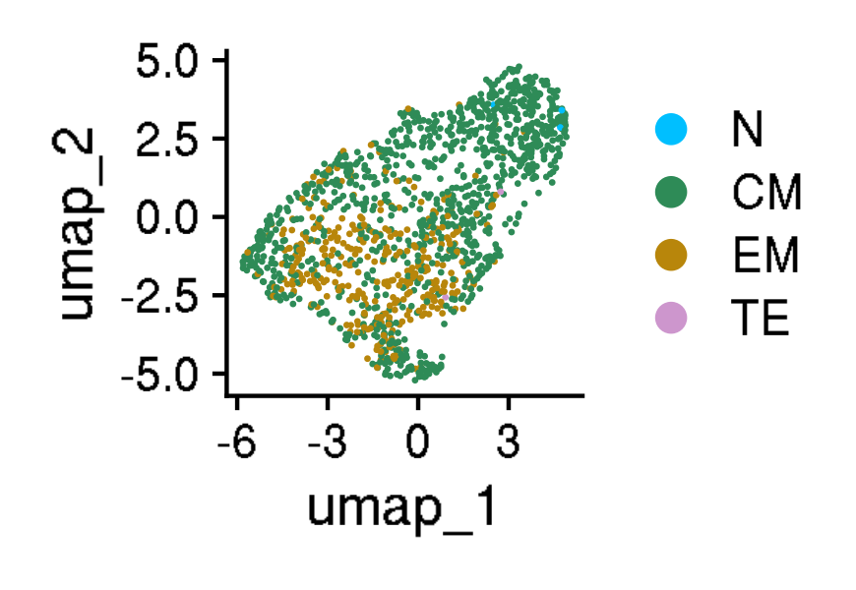
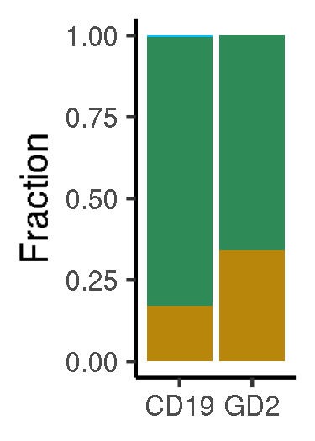
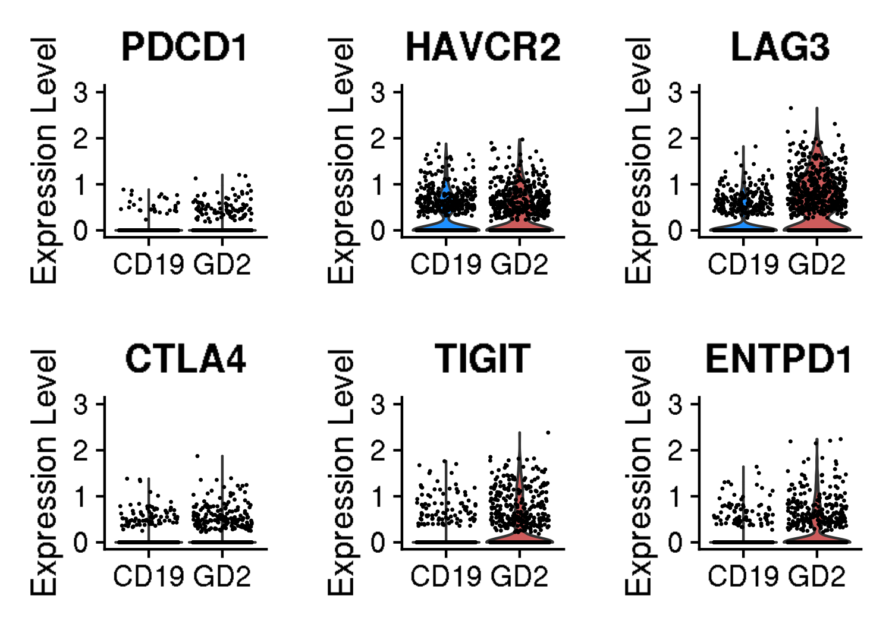






















CARTEx project
Figure 4. Validation in exhaustion-prone models
A
B
C
D
E
F
G
H
I
J
K
L
M
N
O
P
Q
R
S
T
U
V

Slide 10
























CARTEx project
Supplementary Figure 4. validation in exhaustion-prone models
A
B

Slide 11














CARTEx project
Supplementary Figure 5. Activation and resting T cells from healthy donors
A
B
C
D
E
F
G
H
I
J
K
L

Slide 12













CARTEx project
Supplementary Figure 5. T cells from healthy donors and cancer patients (MD Anderson pan-cancer)
A
B
C
D
E
F
G
H
I
J
K

Slide 13





























CARTEx project
Figure 5. CARTEx applied to clinical oncology
A
B
C
D
E
F
G
H
I
J
K
L
M
N
O
P
Q
R
S
T

Slide 14













CARTEx project
Supplementary Figure 6. COVID-19 severity and SARS-CoV-2-reactive T cell exhaustion
A
B
C
D
E
F
G
H
I
J
K

Slide 15












CARTEx project
Figure 6. CARTEx applied to CD8 T cells in autoimmune disorders
A
B
C
D
E
F
G
H

Slide 16











CARTEx project
Supplementary Figure 7. More STAT3 GOF
A
B
C
D

Slide 17










CARTEx project
Supplementary Figure 8. Severe psoriasis is distinct from T cell exhaustion
A
B
C
D
E
F
G
H

Slide 18











CARTEx project
Supplementary Figure 9. BEACH domain deficiencies (autoimmunity caused by defective CTLA-4 trafficking)
A
B
C
D
E
F
G
H
I

Slide 19















CARTEx project
Supplementary Figure 10. T cell exhaustion in neurodegenerative diseases
A
B
C
D
E
F
G
H
I
J
L
K
M

Slide 20
CARTEx project
EXTRA SLIDES

Slide 21








CARTEx project
Supplementary Figures for aging dataset (this is longitudinal data)
A
B
A

Slide 22





CARTEx project
Supplementary Figures for aging dataset (head-to-head comparison with various signatures)

Slide 23






CARTEx project
Supplementary Figures for validation in exhaustion-prone models

Slide 24


CARTEx project
Supplementary Figures for validation in exhaustion-prone models

Slide 25





CARTEx project
Supplementary Figure for CARTEx applied to clinical oncology

Slide 26
























CARTEx project
Supplementary Figure for CARTEx applied to clinical oncology

Slide 27












CARTEx project
Supplementary Figure for CARTEx applied to clinical COVID-19

Slide 28














CARTEx project
Supplementary Figure. More STAT3 GOF (diffusion maps)

